Slide 1

Superstore Sales Dashboard
An interactive Power BI dashboard developed to analyse retail sales performance, customer behavior, product trends, and regional performance to support data-driven business decisions.
Project Domain Retail Sales Analytics
Business Intelligence
Developed By
Jonathan Ogana
Data Analytics Intern
Project Duration
July 2026
AnalystLab Africa Internship Project
Slide 1 of 9

Slide 2




Business Problem & Objective
Core Business Challenges
Analytical Objectives
Despite steady customer acquisition, quarterly gross revenue growth stagnated at 2.4% due to elevated churn following the 90-day post-acquisition window.
Deliver actionable insights using historical order telemetry to identify retention bottlenecks, segment high-value shoppers, and stabilize recurring revenue.
•
Rising Customer Acquisition Cost (CAC up 18% YoY).
•
Quantify customer lifetime value (CLV) drivers.
•
32% drop in repeat orders after first purchase.
•
Pinpoint operational friction during checkout & delivery.
•
Unoptimized discount campaigns diluting profit margins.
•
Deliver executive dashboards for proactive retention.
AnalystLab Africa Internship Project
Slide 2 of 9

Slide 3

Dataset Overview & Schema
The analysis evaluates 24 months of transactional and customer interaction data synthesized across 4 core relational data models with 99.4% completeness.
Data Table | Record Count | Key Attributes | Primary Purpose
Customers Master | 125,000 Rows | CustomerID, Acquisition Source, Signup Date, Geography | Demographic & Cohort Grouping
Transactions Log | 480,000 Rows | OrderID, CustomerID, Order Value, Category, Discount% | Revenue & Spending Pattern Analysis
Fulfillment Data | 480,000 Rows | OrderID, Ship Date, Delivery Time, Courier, Returns Tag | Operational Efficiency Evaluation
Customer Support | 62,000 Logs | TicketID, OrderID, Issue Type, Resolution Time, CSAT Score | Service Satisfaction & Friction Metric
AnalystLab Africa Internship Project
Slide 3 of 9

Slide 4






Key Performance Indicators
90-Day Retention Rate
Average Order Value
Customer Churn Rate
Definition: % of customers making a second purchase within 90 days of signup.
Definition: Net revenue generated per completed purchase order.
Definition: Annual proportion of active buyers becoming inactive (>120 days).
Current Baseline: $74.50
Current Baseline: 28.6%
Current Baseline: 38.2%
AnalystLab Africa Internship Project
Slide 4 of 9

Slide 5


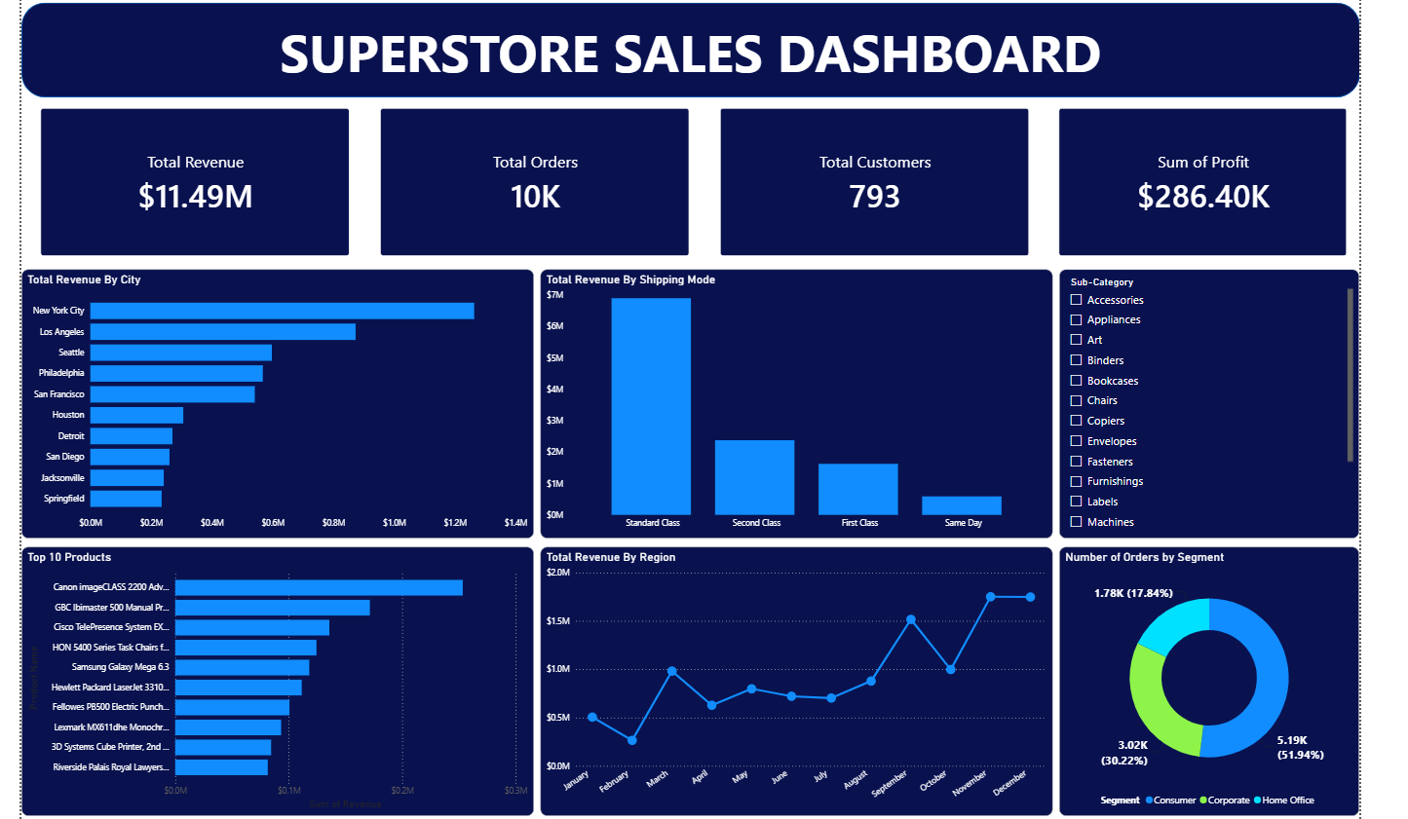


Executive BI Dashboard
Real-Time Telemetry
Centralized BI suite connecting customer transaction logs, delivery fulfillment statuses, and automated churn danger alerts.
Multi-Dimensional Filters
Allows drill-down by customer region, order value tier, product category, and promotional coupon usage.
Automated Alerts
Flags accounts exhibiting low engagement velocity before high-value churn events materialize.
AnalystLab Africa Internship Project
Slide 5 of 9

Slide 6
Key Analytical Insights
Delivery Delays Drive 64% of Early Churn: Customers experiencing fulfillment times exceeding 5 business days exhibit a 3x higher probability of dropping off within 60 days.
Discount Dependency Dilutes Margin: First-time buyers acquired via discounts >30% have a 45% lower retention rate compared to full-price organic signups.
Top 15% VIP Cohort Generates 58% Revenue: High-value customers who purchase across 2 or more distinct product categories generate 4.2x higher lifetime revenue.
Mobile App Users Re-engage 2.1x Faster: App-based shoppers demonstrate an average repeat cycle of 18 days vs. 38 days for desktop website users.
AnalystLab Africa Internship Project
Slide 6 of 9

Slide 7




Strategic Recommendations
Optimize Logistics SLA
Personalized Cross-Selling
App Adoption Push
Enforce 3-day regional fulfillment guarantees and implement automated SMS tracking updates to eliminate early delivery drop-offs.
Launch automated recommendation engines tailored to first-purchase categories to encourage multi-category exploration early.
Incentivize web shoppers to download the mobile app via loyalty rewards, accelerating re-engagement and purchase frequency.
Strategic Recommendations
Slide 7 of 9

Slide 8




Technical Challenges Faced
Data Discrepancies & Silos
Missing Support Telemetry
Inconsistent order status definitions between legacy warehouse ERP and modern checkout gateways required extensive ETL transformation and unified schema definition.
Around 12% of customer service ticket records lacked associated OrderIDs, requiring fuzzy-matching algorithms on customer email and timestamp logs.
AnalystLab Africa Internship Project
Slide 8 of 9

Slide 9



Project Impact & Conclusion
+$11.49M
-22%
Projected Annual Revenue Uplift
Expected Reduction in Churn Rate
Executive Summary
By transitioning from reactive discount marketing to data-driven operational SLAs and targeted cross-selling, the organization can successfully protect customer lifetime value and scale sustainable recurring revenue.
AnalystLab Africa Internship Project
Slide 9 of 9

